Slide 1
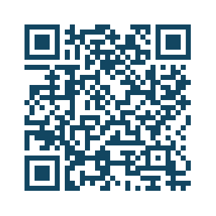
Join Me at the NCS 22nd Annual Meeting
The NCS Annual Meeting offers a diverse range of educational sessions, workshops and interactive discussions aimed at enhancing your skills and knowledge in neurocritical care.
Join over 1,000+ healthcare professionals in San Diego.
Earn up to 21.5+ continuing education credits.
Multidisciplinary sessions focusing on science, clinical practice and quality.

